Slide 1

Introduction to discovering annuity and IUL opportunities

Slide 2
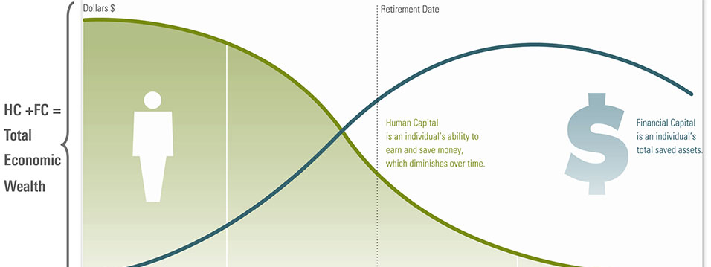

COMPLETE PROTECTION
HUMAN CAPITAL
FINANCIAL CAPITAL
NOTE: For educational purposes only. Not all clients will be approved. Rates and returns can vary. Please consult your financial professional before making any decisions. Products illustrated are accurate as of February 2021

Slide 3


FFL “Four Quadrant” system
IUL
FEX
MP
ANNUITY

Slide 4
ANNUITY DISCOVERY
Protecting Financial Capital with a Fixed Indexed Annuity

Slide 5
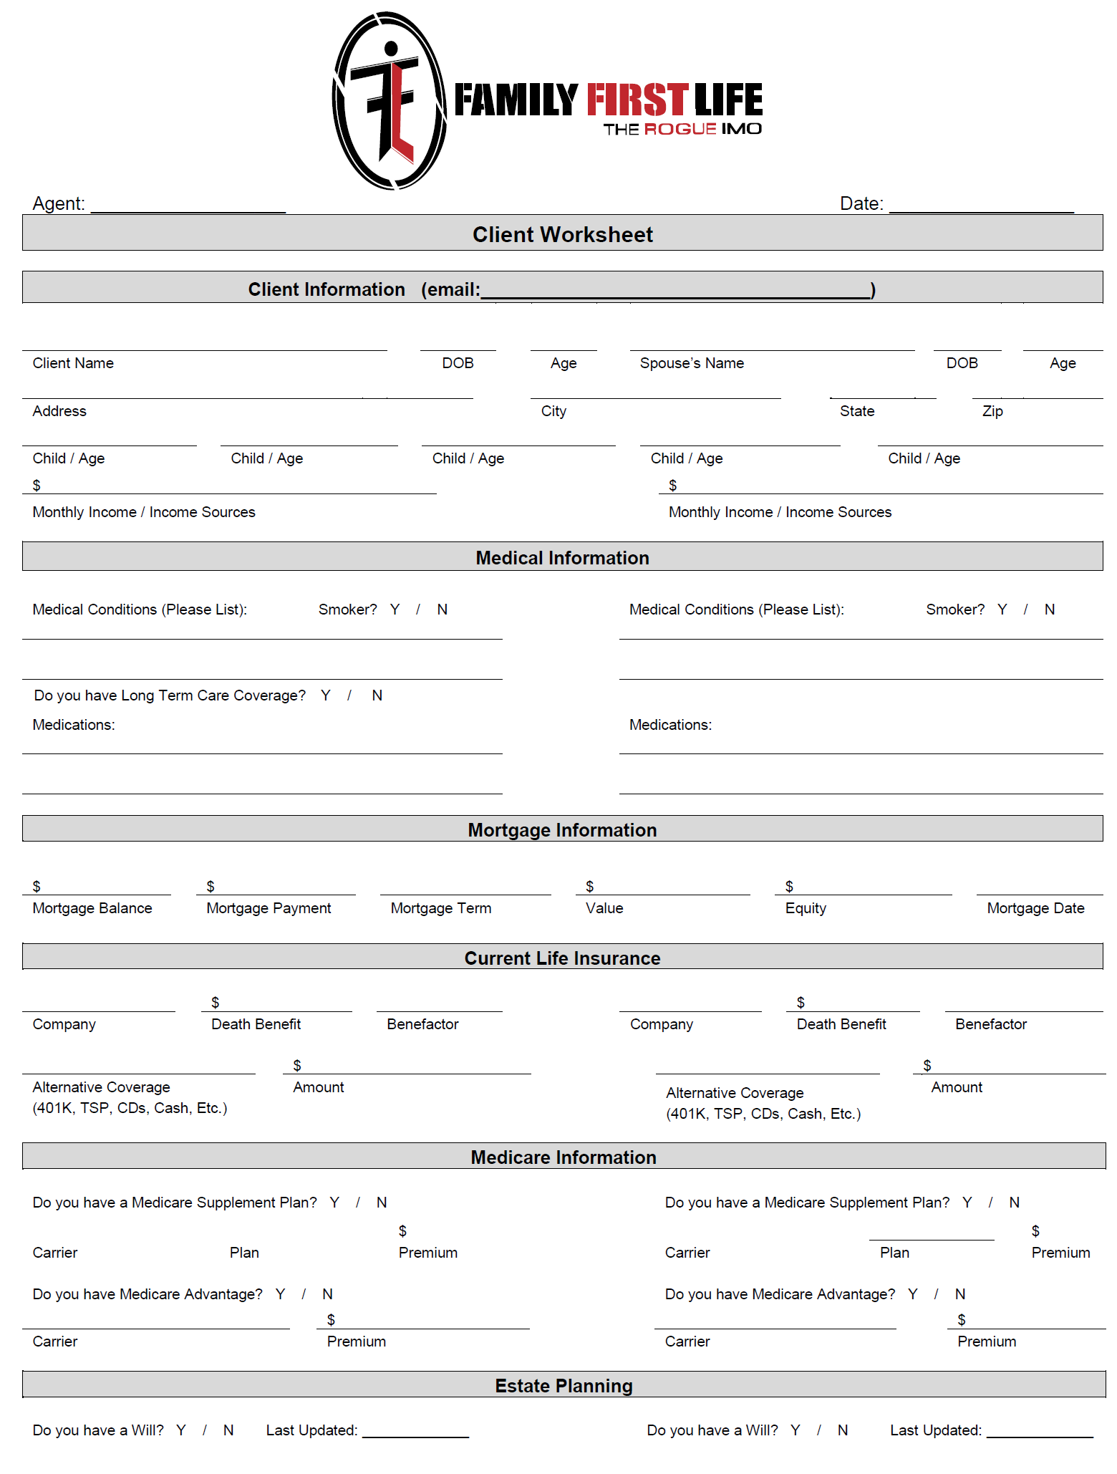
DO YOU HAVE ANYTHING THAT ACTS LIKE INSURANCE?
YES

Slide 6
IS YOUR RETIREMENT PROTECTED?

Slide 7
PROTECT YOUR RETIREMENT
WITH AN FIA
The Fixed Indexed Annuity (FIA) is the fastest growing tool for retirees today. It is popular because it is not an investment of risk, but a guaranteed contract that provides the following:
ELIMINATE market loss – never lose money in the market again!
PARTICIPATE in the upside of the market – much higher earning potential than other safe investments!
Create a PAYCHECK FOR LIFE for you and your spouse – ONLY annuities can provide this!

Slide 8
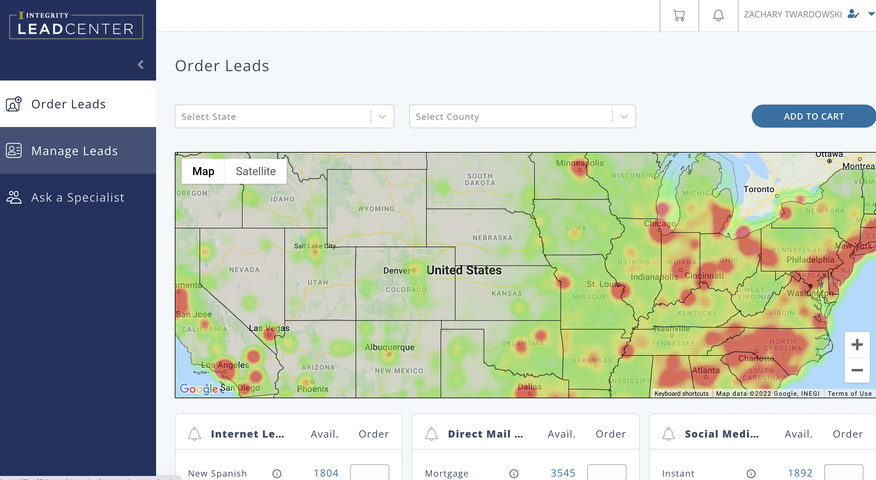

Slide 9

Mary (60)
60 years old
$225,000 IRA
Wants to retire at age 70
Concerned about
  Living too long
  Losing money in the stock market

Slide 10
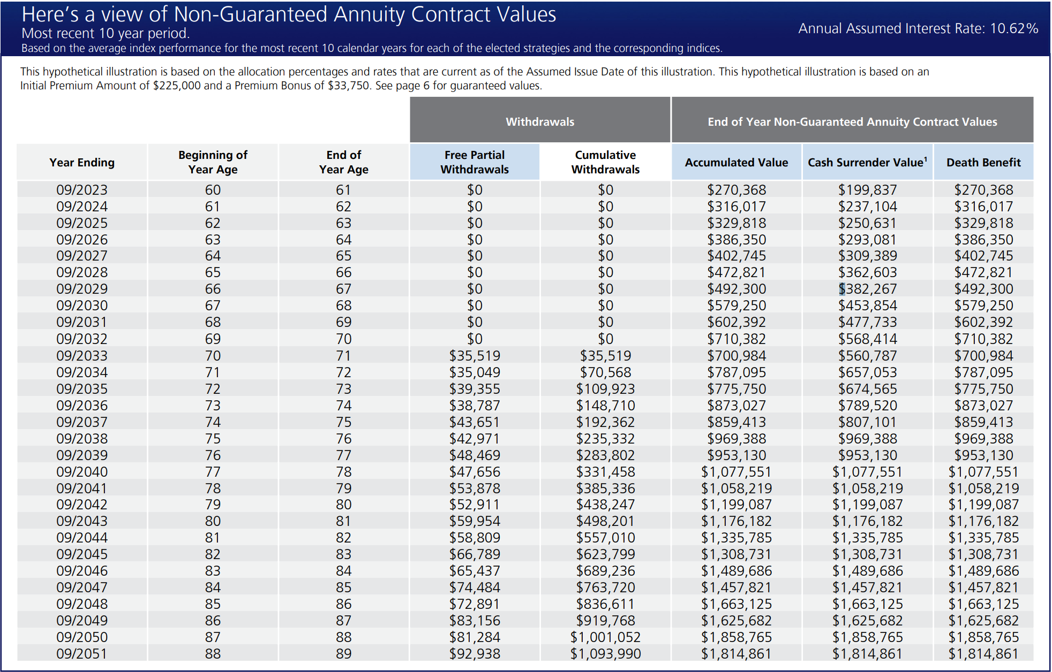

Slide 11
IUL DISCOVERY
Creating Financial Capital Using an Index Universal Life Policy

Slide 12
DO YOU HAVE ANYTHING THAT ACTS LIKE INSURANCE?
NO

Slide 13
HAVE YOU CONSIDERED AN IUL TO SUPPLEMENT YOUR RETIREMENT?

Slide 14
SUPPLEMENT YOUR RETIREMENT WITH AN IUL
First & Foremost an IUL is a life insurance contract that provides a TAX FREE DEATH BENEFIT.
Second an IUL provides cash accumulation value that can be borrowed against – this is the primary reason people purchase an IUL.
The monthly premium, if structured correctly, goes to pay for BOTH benefits in one policy.

Slide 16

Angela (30)
30 years old
No pension – self employed
Concerned about future taxes
Wants to make sure children have opportunity for college
Concerned about LTC burden

Slide 17
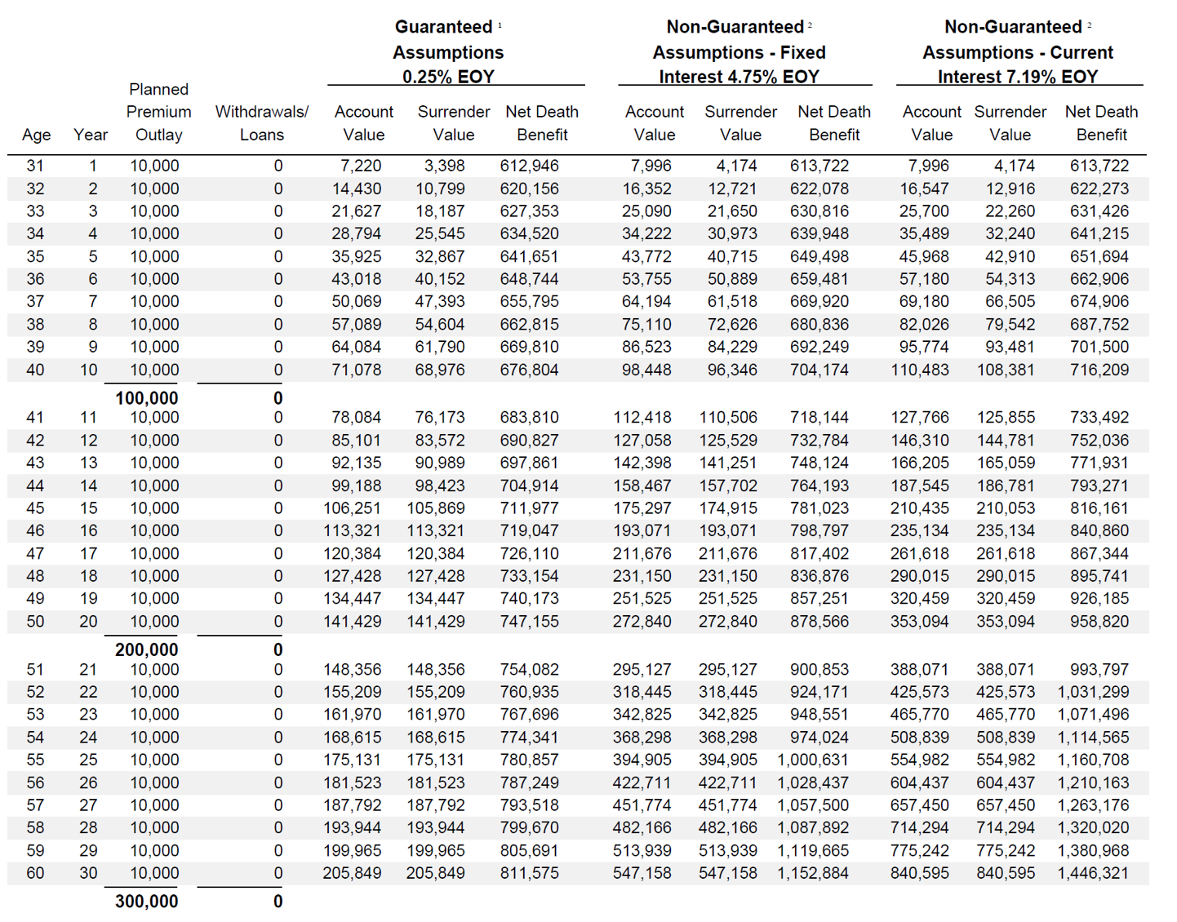

Slide 18
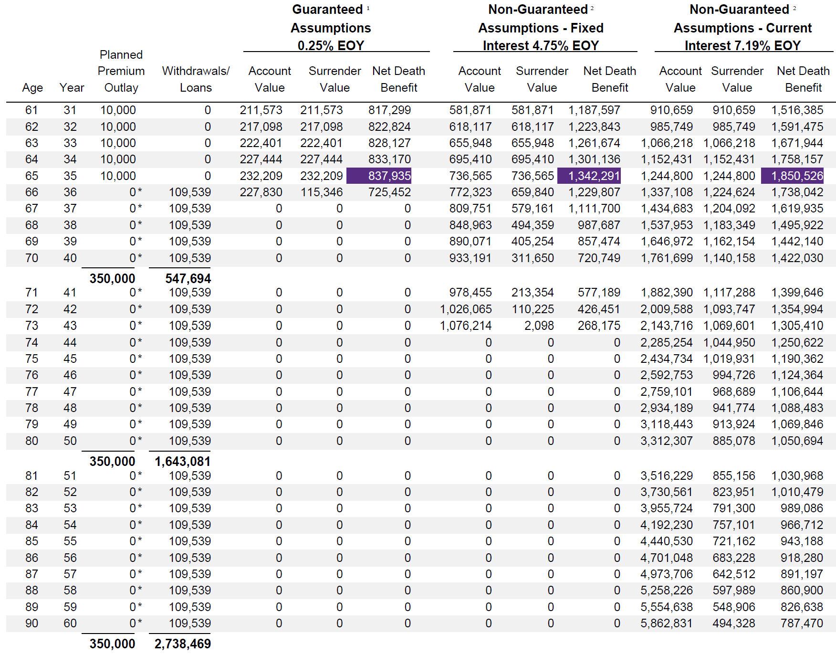

Slide 19
1. Top Annuity Carriers:
- Athene
- F&G Annuity
- Nassau
- Global Atlantic
- SILAC
- NLG
2. Top IUL Carriers:
- Mutual of Omaha
- F&G IUL
- NLG
- North American
- ANICO
3. Training
- PST for each annuity product
- Annuity Suitability in your state
CONTRACTING@FFLAMS.COM
CONTRACTING

Slide 20
1. Annuity Processing Team
- Firelight Eapp (Auto set up when using AAS)
- Processing/Funds Transfer
2. Training
- Family First Life TNL – Friday @ 8am PST
- FFLAMS.com – video library
- Monthly webinars
3. Consumer Tools
- FIABenefits.com
- Client facing FIA & IUL Videos
- Marketing Materials
INFO@FFLAMS.COM
RESOURCES

Slide 21

Ask Golden Question EVERY TIME
Embrace Failures
Invest – in yourself through training & the commitment to growing
ONE Annuity Every Month
ONE IUL Every Week
TRACK YOUR ASK A SPECIALISTS
GOALS

